Slide 1


Generative AI
Full Stack Developer

Slide 2
Course D : Agentic AI

Slide 3
01
Introduction to LLM-Based Agentic Design
From Static Chatbots to Autonomous AI Systems

Slide 4

Agenda
What Are LLM-Based Agents
Practice 2 – Identify the Pattern
How They Differ from Traditional AI
Real-World Examples
Core Architecture & Thought Loop
Future of LLM Agents
Key Design Principles
Practice 3 – Scenario Challenge
Practice 1 – Agentic or Not?
Summary & Next Steps
Core Design Patterns:
Planning
Tool Use
Reflection
Multi-Agent Collaboration

Slide 5



What Is an LLM-Based Agent?
An LLM-based agent uses a large language model not just to reply,
but to decide, act, and adapt.
Analogy → Intern vs Assistant Manager
Intern (chatbot): waits for tasks.
Manager (agent): sets goals, plans, executes, evaluates.

Slide 6




Core -Triad
LLM
Brain
Tools
Hands
Memory
Experience

Slide 7
How Agentic AI Differs from Traditional AI
Analogy → Search engine vs Research assistant.
Feature | Traditional LLM | Agentic LLM
Interaction | Prompt → Response | Multi-step Reasoning
Context | Stateless | Persistent awareness
Control | Human driven | Self-directed
Tool Access | None | Can use APIs, code
Output | Text | Achieved Outcome

Slide 8





Architecture: component details
Analogy → Movie crew: Director (LLM), Crew (Tools), Editor (Reflector), Producer (Controller).
LLM Core
LLM Core: Reasoning and decision-making
Planner: Splits goal into steps
Tools: Execute actions (APIs, code)
Reflector: Self-checks outputs
Controller: Runs the loop
Planner
Controller
Tools
Reflector

Slide 9






The Thought–Action Loop
Observe
Act
Repeat
Reflect
Think
Analogy → Detective loop: observe → hypothesise → test → revise
while not done:
thought = llm("What should I do next?")
action = decide(thought)
result = perform(action)
feedback = llm(f"Did this work? {result}")

Slide 10



Design Principles
Goal orientation: Agents pursue outcomes, not one-off answers.
Modularity: Planner / Actor / Reviewer roles simplify control.
Reflection: Agents evaluate themselves like humans do.
Analogy → A research team
PI (planner): designs experiments and guides research direction.
Experimenter (worker): collects data and performs analyses.
Peer reviewer (reflector): validates findings and suggests improvements.

Slide 11

Practice 1 – Agentic or Not?
Objective: Judge if each task needs autonomy → is it agentic?
Scenario | Agentic (Y/N) | Why or Why Not?
"Translate this paragraph to French." | ␧
"Find and book a flight to Delhi under $2000." | ␧
"Summarise this one article." | ␧
"Manage team calendar and follow up emails." | ␧
"List products from our FAQ." | ␧
"Monitor stock prices and alert on thresholds." | ␧
Hint:
Agentic = needs goal pursuit, planning or reflection.

Slide 12
Practice 1 – Agentic or Not?
Objective: Judge if each task needs autonomy → is it agentic?
Scenario | Agentic (Y/N) | Why or Why Not?
"Translate this paragraph to French." | ␧
"Find and book a flight to Delhi under $2000." | 🗹
"Summarise this one article." | ␧
"Manage team calendar and follow up emails." | 🗹
"List products from our FAQ." | ␧
"Monitor stock prices and alert on thresholds." | 🗹
Hint: Agentic = needs goal pursuit, planning or reflection.

Slide 13
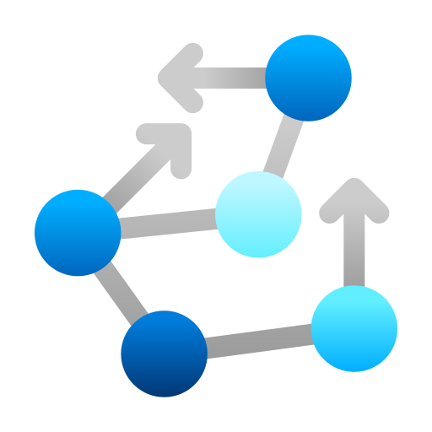



What Are Agentic Design Patterns?
Design patterns: reusable blueprints for structuring LLM agents.
Purpose: reduce complexity, increase reliability.
Analogy → House plans: different layouts, same engineering logic.
Blueprints specify standard components (foundation, walls, plumbing)
Each house looks unique but shares reliable structure
Focus today on 4 core patterns most used in modern LLM frameworks.
Planning Tool Use Reflection Multi-Agent

Slide 14
Pattern 1: Planning / Task Decomposition
Breaks a goal into smaller steps the agent can execute.
goal = "Launch a Trip to Europe"
steps = llm("Break the goal into ordered subtasks.")
Use Case:
Research assistants, project agents, workflow automation.
Analogy → Trip planner creates itinerary.

Slide 15

Pattern 2: Tool Use
Agent decides when to call external APIs or functions.
Analogy → Doctor ordering X-rays before diagnosis.
def search_tool(q): return "Results for " + q
agent.run("Find latest papers on Agentic AI.")
Use Case:
Information retrieval, automation, data enrichment.
Like a doctor who knows exactly when to order tests, an agent determines when external tools will provide the most valuable information.

Slide 16
Pattern 3: Reflection / Self-Critique
Agent reviews its output → detects errors, revises.
Analogy → Writer revising draft:
write first draft → review for issues → revise and improve..
draft = llm("Summarise agentic design.")
review = llm(f"Critique this summary:\n{draft}")
improved = llm(f"Rewrite using feedback:\n{review}")
Use Case:
Summaries, reports, code generation..

Slide 17
Pattern 4: Multi-Agent Collaboration
Multiple agents with roles (Planner, Worker, Reviewer).
Analogy → Startup team:
CEO plans, engineers build, QA reviews.
planner → worker(s) → reviewer
Use Case:
Complex projects (content creation, research pipelines).

Slide 18
Practice 2 – Identify the Pattern
Objective: Pattern identification
Scenario | Best Pattern
AI assistant decomposes goal into subtasks. | ␧ Tool Use
Chatbot calls currency API for live rates. | ␧ Planning
Legal bot reviews its own summary for completeness. | ␧ Multi Agent Collaboration
Content workflow uses Planner, Writer, Reviewer agents. | ␧ Reflection
Prompt:
Which patterns often combine in practice?

Slide 19
Practice 2 – Identify the Pattern
Objective: Pattern identification
Scenario | Best Pattern
AI assistant decomposes goal into subtasks. | ␧ Tool Use
Chatbot calls currency API for live rates. | ␧ Planning
Legal bot reviews its own summary for completeness. | ␧ Multi Agent Collaboration
Content workflow uses Planner, Writer, Reviewer agents. | ␧ Reflection
Prompt:
Which patterns often combine in practice?

Slide 20




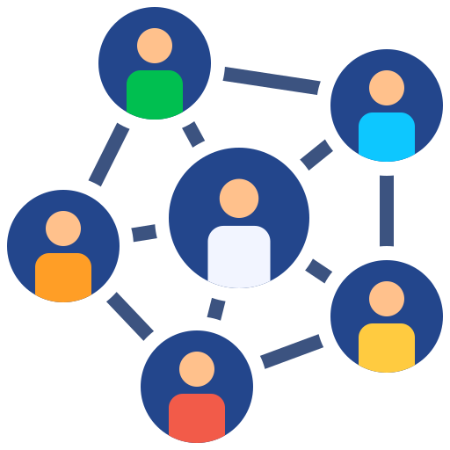

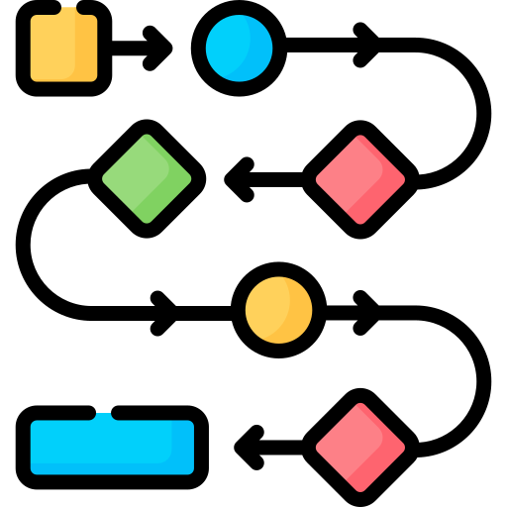
Popular Frameworks
Gemini 1.5 Pro → Tool Use + Reflection
LangGraph → Planning + Execution nodes
Tool Use
Reflection
Planning
Execution
AutoGen → Multi-Agent dialogue pattern
CrewAI → Planner/Worker/Reviewer architecture
Multi-Agent
Dialogue
Planner
Worker
Reviewer
Analogy → Mini companies of LLMs working in teams.
Collaborative Structure Specialized Roles Coordinated Workflows

Slide 21
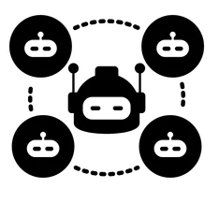

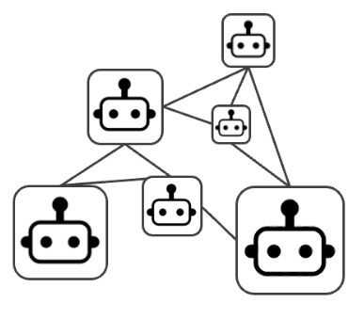

Future of LLM Agents
Meta-agents controlling others.
Hierarchical systems where higher-level agents coordinate and direct specialized sub-agents
Persistent memory and identity.
Agents with consistent personality traits, evolving knowledge bases, and contextual awareness
Collaborative ecosystems of agents.
Specialized agents working together in emergent systems, like organizations
Analogy → From a single brain → society of minds.
Single Model
Society of Minds
Just as human society evolved from individual actors to complex civilizations, AI systems are evolving from single models to interconnected cognitive networks.

Slide 22
Practice 3 – Scenario Challenge
Objective: Choose best fit
Scenario | Which Setup Fits Best?
AI studio automates research, writing, editing. | ␧ Multi-Agent
Research bot fetches and summarises papers. | ␧ Planning + Tool Use
Compliance bot checks output before approval. | 🗹 Reflection
Conversational planner breaks goal into steps and delegates. | ␧ Planning + Multi-Agent
Developer assistant tests and fixes its own code. | ␧ Reflection + Tool Use
Prompt:
When would you add reflection to a multi-agent workflow?

Slide 23
Practice 3 – Scenario Challenge
Objective: Choose best fit
Scenario | Which Setup Fits Best?
AI studio automates research, writing, editing. | ␧ Multi-Agent
Research bot fetches and summarises papers. | ␧ Planning + Tool Use
Compliance bot checks output before approval. | ␧ Reflection
Conversational planner breaks goal into steps and delegates. | ␧ Planning + Multi-Agent
Developer assistant tests and fixes its own code. | ␧ Reflection + Tool Use
Prompt:
When would you add reflection to a multi-agent workflow?

Slide 24

Summary & Next Steps
LLM Agents = LLM + Tools + Autonomy.
4 Key Patterns:
Planning
Tool Use
Reflection
Multi-Agent Collaboration
You can now recognise when a task needs agentic behavior and which pattern fits.
Next Steps:
Explore LangGraph, AutoGen, CrewAI.
Imagine an agent for your own workflow — what pattern would it need?
LLM
Brain
Tools
Action
Autonomy
Loop

Slide 25
Q/A

Slide 26
Thanks

